Slide 1
IDENTITY AND ACCESS MANAGEMENT ( IAM )
AWS Console
Root User
IAM User
AWS Access Methods
IAM Group
IAM Policy
IAM Role

Slide 2
WHAT IS AWS ROOT USER, IAM USER AND IAM GROUP
AWS Root user is the user used to create the AWS account
The Root user has permission to do everything
IAM user is the individual user we create to access an AWS account
This users lack permission by default when they are created
AWS Recommended not to use the Root user for administrative tasks
Create an IAM user instead and give the user the permission to conduct administrative tasks instead.
IAM Group is a collection of IAM users
You simply create IAM group, add users that are related in functions to the same group for easy access management.
Creating 40 users and applying 40 permission to each is stressful than putting all in a group and apply 1 access to that group, which everyone will inherit, because they shared the same group.

Slide 3
HOW DO WE ACCESS AWS ?
AWS Console
This is valid mostly for human use case
This require username and password as authentication means.
Programmatically
This is mostly used by human and applications
This access mode can be via your CLI/Terminal or via your codes
Programmatic access require aws CLI installed and a Valid Access Key and Secret Key
This Keys are used to identify who you are
To access programmatically …..
You simply create an IAM user
Create an Access Key and Secret Key

Slide 4

LET’S TAKE A DEEP BREATH
TO DEMONSTRATE WHAT WE SAID
SO FAR
Login using Root User
IAM Dashboard
Create IAM user
Create IAM group
Create IAM Access Key and Secret Key
Add an IAM User to an IAM Group

Slide 5
LET’S TALK ABOUT IAM POLICY IN AWS
What is an IAM Policy?
This is a JSON/PYTHON DICTIONARY like document that contain statement that define the permission for an IAM entity e.g IAM user.
We have 2 types of IAM Policy
AWS Managed - Policy already created by AWS for us to use
Customer Managed - Policy created by us from scratch.
You will most likely create your own policy 95 Percent of the time
There is no way out of not understanding IAM Policy 🤣

Slide 6
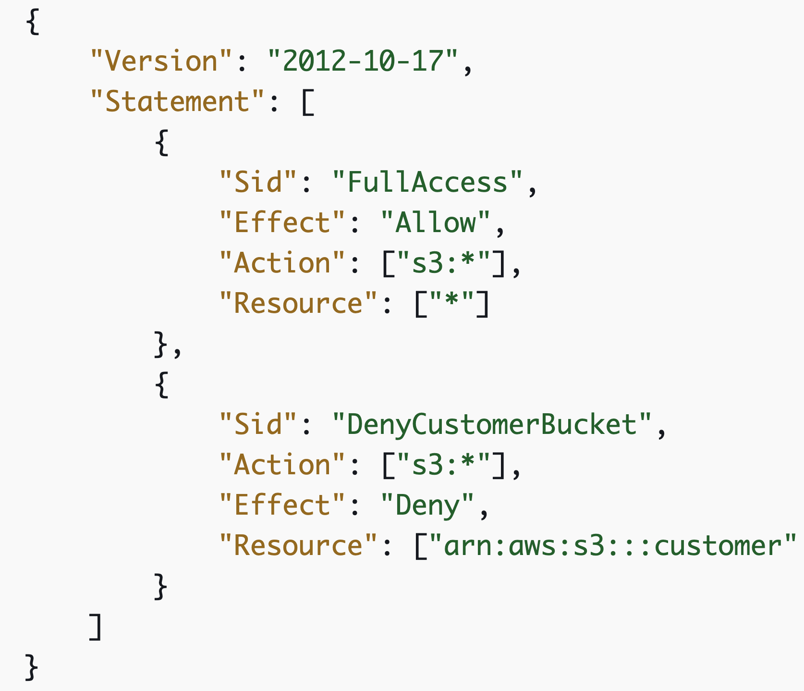
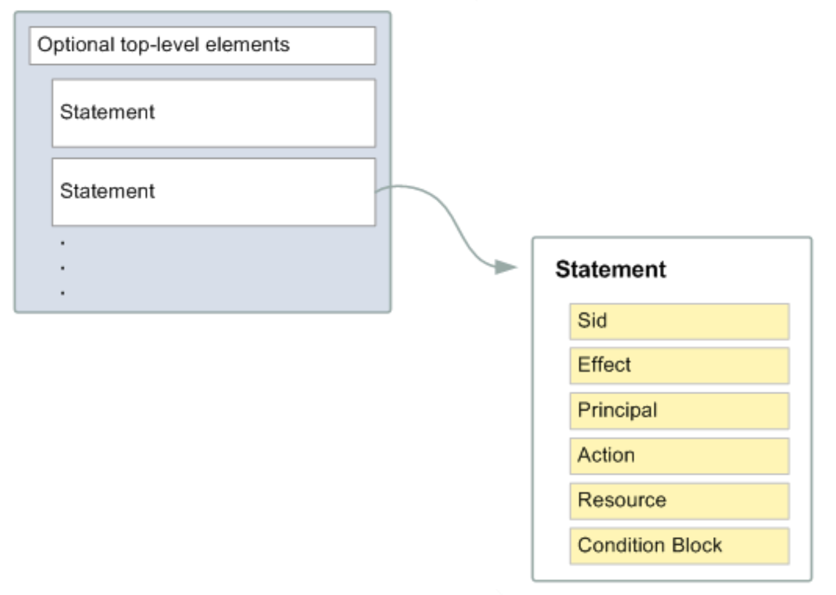
LET’S HAVE A FIRST LOOK OF AN IAM POLICY
AWS REFERENCE
https://docs.aws.amazon.com/IAM/latest/UserGuide/access_policies.html#access_policies-json

Slide 7
LETS UNDERSTAND THE POLICY PARAMETERS
Version - It’s the Version of the policy JSON pretty much
Statement - Container for the actual instruction
Sid - A unique for a statement, since the statement can be a list of statements
Effect - This indicate whether to allow or deny. Possible values is Allow or Deny.
Principal - Optional field, out of the scope of this class
Action - This is a list of actions that the policy Allow or Deny
All AWS Action Reference is HERE
Condition - Optional, out of the scope of this class

Slide 8
LET’S GO THROUGH THE IAM POLICY IN THE AWS CONSOLE

